Slide 1
BRAIN TUMOR PREDICTION
PRESENTED BY
MANISHA PRIYADHARSINI

Slide 2
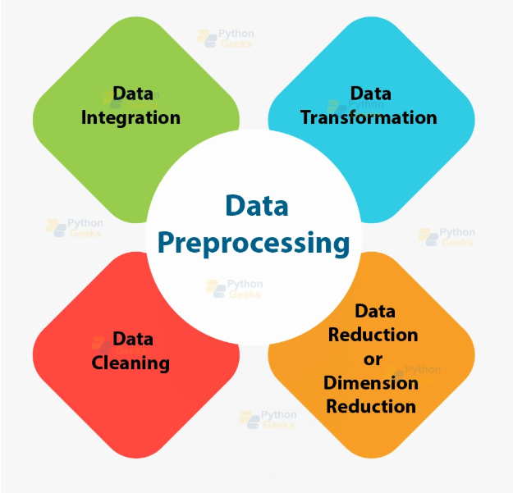
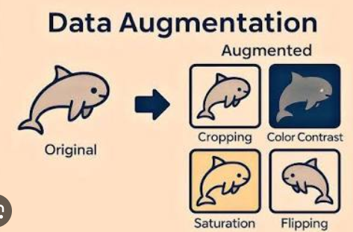
DATA PREPROCESS & AUGMENTATION

Slide 3
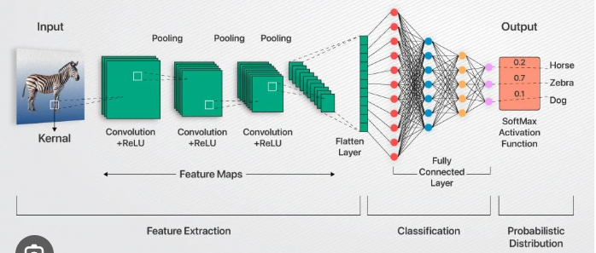
CUSTOM CNN
Limited computational resources
Performance Optimizaton
Bench marking
Education value

Slide 4
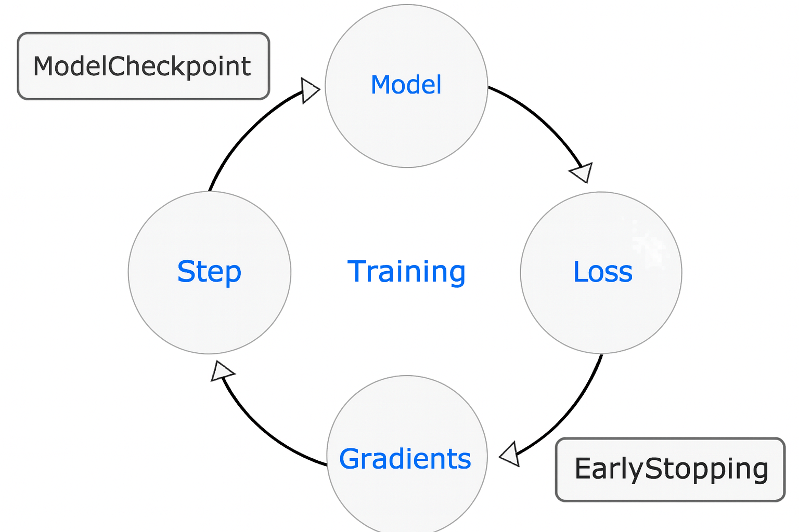
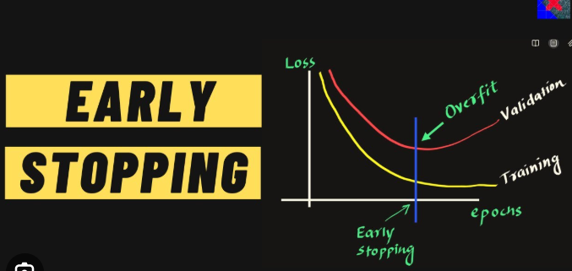
callbacks

Slide 5
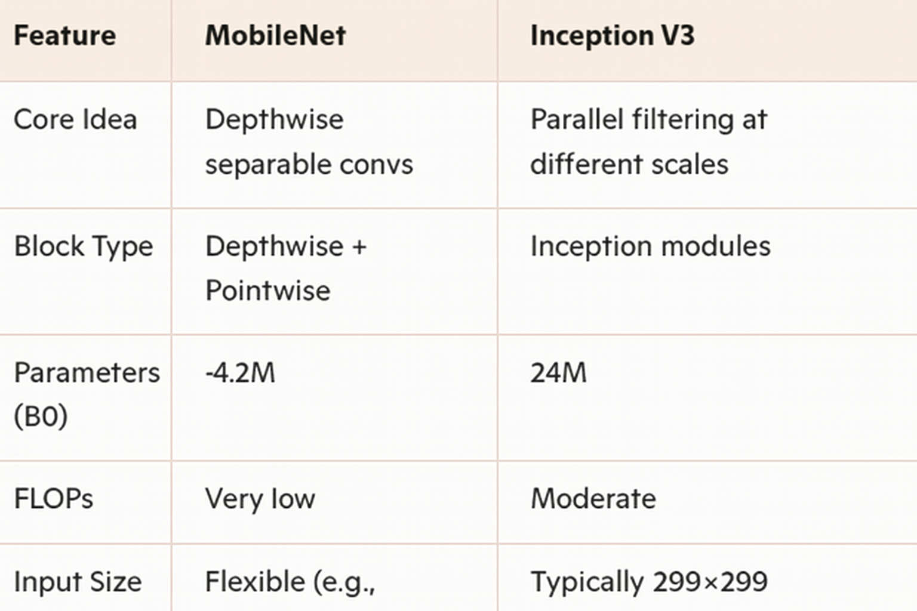
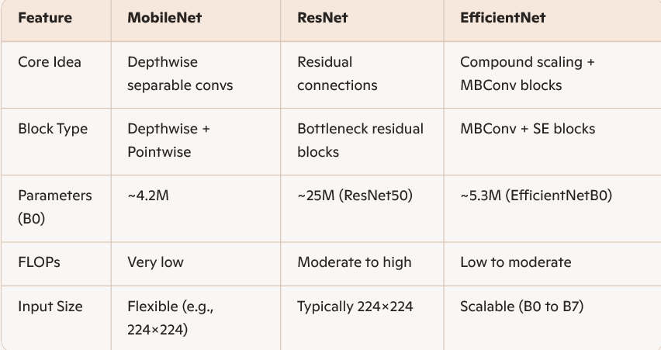
Compare models

Slide 6
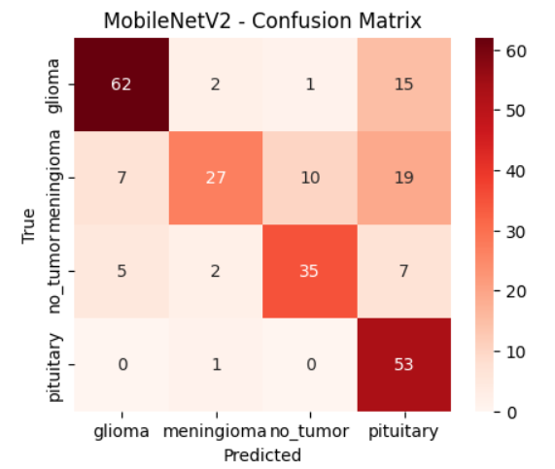
CONFUSION MATRIX
Optimizers Validation Loss Metric
SGD Accuracy Category Crossentropy
Adam Precision & Recall MSE
RMSProp F1 Score

Slide 7


